Slide 1
SLA Escalation
Chris Connolly – Christo IT Services

Slide 2
Presenter
Chris Connolly
MSP Co-owner & COO – Christo IT Services
ConnectWise + LabTech Partner
Masters in Computer Engineering
Creator of NilearOS for ConnectWise
Have studied ConnectWise SLA for the past three years
Have studied hundreds of other MSPs’ SLAs
SLA Evangelist

Slide 3
Goals
Prove your SLA KPIs can be as important as your P&L report
Prove that SLA Escalation to Ticket Status mapping is not up to interpretation or personal preference but is logic based
Prove that correcting your SLA Escalation to Ticket Status mapping will not break your Workflow or Reports
Ensure that when you return to your offices, you can and will actually apply what you have learned today

Slide 4
Overview
SLA Definition
Why SLA is Important
SLA Values
Tiers or Pods
KPIs
SLA Escalation Mapping
SLA Escalation Analysis
SLA Escalation Rules
How to Analyze & Correct your SLA settings

Slide 5
SLA Definition
What does SLA stand for?
Service Level Agreement
How do we (ConnectWise) use it?
As a time measurement of 5 different SLA States
We have NOT Responded (New)
We have Responded (Assigned)
We have a Resolution Plan (In Progress)
We are Waiting (Waiting for Client/Parts)
We have Resolved the issue (Completed/Closed)
Time is usually calculated during business hours only

Slide 6
SLA Definition
Traditionally, SLA is used as a contract for expected response times with a client
For Example, MSP X will respond to a client request within 2 business hours and MSP X will begin working on the ticket within 6 business hours of the request
Contracted times are usually well above typical response times – putting the MSP in a good position to meet or exceed their SLA

Slide 7
Why SLA is Important
SLA contains the most important KPI (Key Performance Indicators) for Operations
Any procedural, employee, role, responsibility, client or workflow change will affect your SLA KPIs
SLA KPIs are the benchmark for operational efficiency – no other measurable value can provide the same degree of responsive feedback from change

Slide 8
Typical Operation Metrics
How many tickets did we close today/week?
How many tickets were still open at the end of the day?
Why less useful?
Number of incoming tickets each day/week is not static and therefore is always going up and down regardless of company changes
If open tickets are usually under 5 tickets than there is too little numeric data to validate improvements

Slide 9
Typical Operation Metrics
How many hours did each tech work today?
What % of the tech’s time was billable?
Why less useful?
I can replace a 9-hour/day, 90% billable 15-year tech veteran with a 10-hour/day 95% billable entry-level tech; however, the fewer hours, less billable 15-year tech still out produces the entry-level tech
I can completely change the companies procedures but the tech will still be working 9-hour days at 90% billable

Slide 10
SLA Accrued
Each time a ticket is move to or back to an SLA Escalation, the SLA time is accrued
Accrued works well for “We have a Resolution Plan” and “We have Resolved the issue”
It does not work well for “We have NOT responded” or “We have responded”
ConnectWise only tracks “We have resolved an issue” as SLA accrued

Slide 11
SLA Per Escalation
Tracking time for each SLA Escalation can be even more valuable than accrued
Per Escalation is perfect for “We have NOT responded” and “We have responded”
I want all tickets to be responded to in under 15 minutes, each time they are in “Not responded”
ConnectWise does not track SLA per Escalation but uses First Escalation

Slide 12
ConnectWise SLA Values
Response Time
Time in We have NOT responded
First Escalation Only
Resolution Plan Time
Combined Time in We have NOT responded and We have responded
First Escalation Only
Resolution Time
Combined Time in We have NOT responded, We have responded and We have a Resolution Plan
Accrued

Slide 13
ConnectWise SLA Values

Slide 14
Customer Facing SLA
Classic Approach
Contract with client
Response times set to the maximum time acceptable by clients
Higher paying contracts may be offered faster response times
Problems with this approach
We are setting the “bar” as low as possible for our company
Some numbers make no sense – Time to Resolve
We configure workflow rules based on these low as possible response times

Slide 15
Operations SLA
Operational Approach
Response times are determined by management for internal reporting and KPIs
Why is this Approach better?
Response times can be set to minimum values rather than maximum values
We can have workflow rules respond faster to potential issues
We can pick and choose which SLA KPIs are actually important

Slide 16
Tier Approach
A Tier approach attempts to control access to higher costs resources
Tiers use a defined procedure for escalating tickets to the next tier
Example
Dispatch Manager routes tickets
Tier 1 Support attempts to resolve ticket
Unresolved tickets are escalated to Tier 2 Support
Tier 2 Support attempts to resolve tickets from Tier 1
Unresolved tickets are escalated to Tier 3 Support
Tier 3 Support must ultimately resolve the tickets from Tier 1 or 2

Slide 17
Tiers Approach
Pros
Controls labor costs
More than one expertise or set of eyes on the tickets
SLA can be managed well through proper Workflow
Cons
Time In Responded and Time In Progress can double or triple when a ticket is escalated multiple times – negating the labor savings
End-user must wait for the ticket to get to the right tech before their ticket can actually be resolved
The lower paid/experienced Tier 1 or 2 is, the more tickets need to be escalated
Big Business approach to support Small Business Owners

Slide 18
Pod Approach
A Pod approach groups a subset of clients and techs together
A client will typically be serviced by someone within their assigned team or pod
Techs take ownership of the clients in their pod
Example
Four Techs are assigned to 33% of the company’s clients
One tech in the pod is assigned as the pod leader and is primarily assigned an Account Manager for clients
At least one other tech is advanced enough to work on high-end projects and advanced server/network issues
Each tech assigned as Primary Tech is responsible for all pro-active work for that client

Slide 19
Pod Approach
Pros
Clients are routed directly to the tech that will resolve their issue
Clients get a “small business” feel as they get the same small group of techs every time
SLA times are at their lowest as there is little need to escalate tickets
SLA can still be managed through proper Workflow
Team can focus on their subset of clients rather than trying to get to know all the MSP’s clients
Cons
Labor Costs can increase as more Level 2 support techs are required than Level 1in order to reduce escalations

Slide 20
Key Performance Indicators
Average Time to Respond (Per Escalation)
Average Time to In Progress (Per Escalation)
Tech Business Hours Ratio
Minutes logged during business hours / minutes logged
Ex. Techs are performing only 75% of their work during business hours
Average Work Time to Non-Work Time Ratio
Average In Progress Time / (Average Time To Respond + Average Time to In Progress)
Ex. For every 1 minute of work performed a ticket is on the board for 7 minutes
Average Waiting Time Ratio
Average Waiting Time / (Average Time To Resolve + Average Waiting Time)

Slide 21
Key Performance Indicators
% of Tickets Responded to under 5 minutes
% of Tickets Responded to under SLA Per Escalation
% of Tickets Responded to over SLA Per Escalation
% of Tickets to In Progress under 15 minutes
% of Tickets to In Progress under SLA Per Escalation
% of Tickets to In Progress over SLA Per Escalation
% of Tickets Time to Resolved under 30 minutes

Slide 22
Key Performance Indicators
These KPIs need to be evaluated both as company-wide and as per employee
The Per Employee lets you determine who is brining your SLA average up and who is bring your SLA average down
The Company-wide average tells you if changes to personnel or procedures are improving or worsening your response times

Slide 23
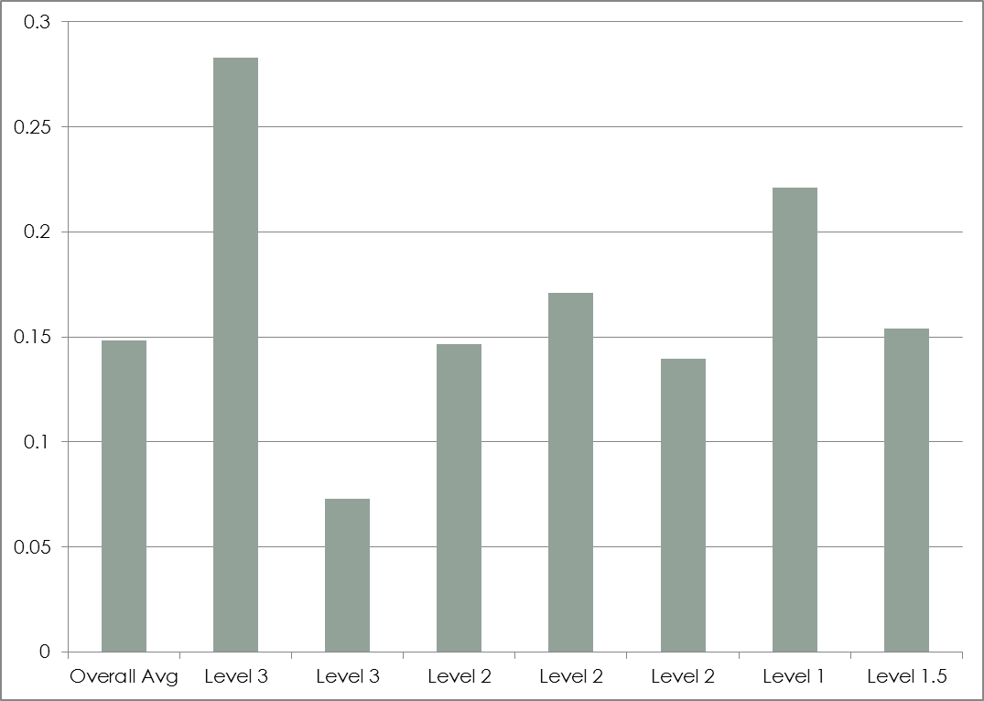
Work/Non-Work Time Ratio

Slide 24
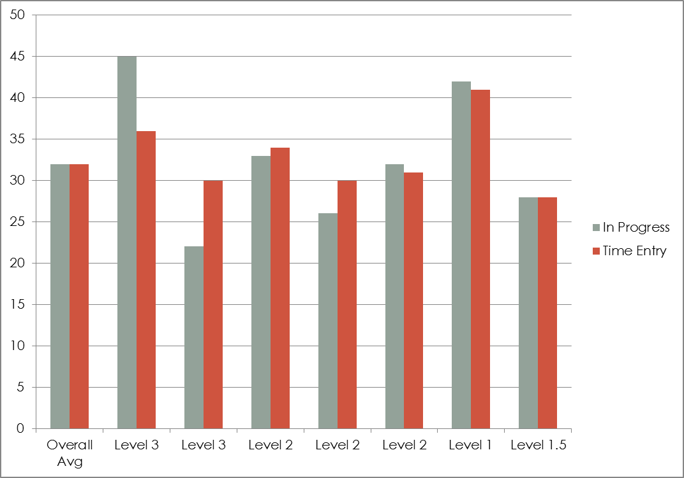
In Progress vs. Time Recorded

Slide 25
Key Performance Indicators
What are we NOT using as KPIs
Average Time to Resolve
Each “In Progress” time will be different – Not all tickets can be resolved in less than 2 hours
Average We have NOT Responded First Escalation Only
Average We have Responded First Escalation Only

Slide 26
SLA Escalation Mapping
SLA KPIs are only valid when the following exist in your company
Real-time Ticketing
Everyone is entering and updating tickets within ConnectWise in real-time
Correct SLA Escalation Mapping
Mapping Service/Project Board Ticket Statuses to their correct SLA Escalation Value
Even if you do not plan on using SLA KPIs today, you cannot have historic SLA KPIs if the above is not already in place

Slide 27
SLA Escalation Mapping
95% of ConnectWise Partners have their SLA Escalation mapped incorrectly
Standardization across MSPs is almost non-existent
Major Pitfalls that have led to the state
MSPs never bother to set/correct SLA Escalations
Groupthink
Outsourced to an external consultant/expert
“Our SLA numbers are good so they must be set correctly”
“Changing our SLA Escalations would break our workflows”
“Changing our SLA Escalations would break our reporting”
The belief that SLA Escalation mapping is MSP specific and should be customized
No single resource to define and standardize CW SLAs

Slide 28
SLA Escalation Mapping
SLA Escalation Mappings are the same for everyone
The following are universally correct
“We have NOT responded”
New, New (Email Connector), New (Portal), Queued
“We have responded”
Assigned
“We have a Resolution Plan”
In Progress, WIP, Work In Progress
“We have a Resolution”
Completed, Closed
“We are Waiting”
Waiting on Parts, Waiting on Vendor, Waiting on Client

Slide 29
SLA Escalation Mapping
What about “Re-opened” Ticket Status?
Do you know your company’s SLA Escalation?
Is it “We have NOT responded”?
Is it “We have Responded”?
What about “Schedule” Ticket Status?
Do you know your company’s SLA Escalation?
Is it “We have Responded”?
Is it “We have a Resolution Plan”?
Is it “We are Waiting”?
The answer must be the same for everyone

Slide 30
SLA Escalation Mapping
If we cannot agree on “Schedule”, how can one claim there is only one acceptable answer?
The answer lies in the smartest thing ConnectWise every did with regards to SLAs, they used the word “escalation”
It is through the analysis of escalation state that it is possible to logically derive the correct SLA Escalation mapping for a ticket status

Slide 31
SLA Escalation Analysis
The first step in SLA Escalation Analysis is to assume your Service Board must have all Ticket Status names swapped out with their mapped SLA Escalation value
Can you run your company with just
“NOT Responded”
“Responded”
“Resolution Plan”
“Resolved the issue”
“Waiting”

Slide 32
SLA Escalation Analysis
Second, could you create workflow rules to manage your SLAs using just SLA Escalation statuses, not Ticket statuses
This is where we really start to remove the duality of SLA Escalation mapping

Slide 33
SLA Escalation Analysis
 | Ticket Status
9:00 AM | New
 | Assigned
10:00 AM | Work In Progress
 | Escalate to Lead
11:00 AM
12:00 PM
1:00 PM
 | Work In Progress
2:00 PM | Escalate to Engineering
3:00 PM | Work In Progress
 | Resolved
4:00 PM
Ticket Status Report
----------------------------------------------------------
No one has reviewed ticket: 15 minutes
Someone is assigned: 4 hours 30 minutes
Someone is working on it: 2 hours
Time to Resolve: 6 hours 45 minutes

Slide 34
SLA Escalation Analysis
 | Ticket Status | SLA Escalation
9:00 AM | New | We have NOT responded
 | Assigned | We have responded
10:00 AM | Work In Progress | We have a Resolution Plan
 | Escalate to Lead
11:00 AM
12:00 PM
1:00 PM
 | Work In Progress
2:00 PM | Escalate to Engineering
3:00 PM | Work In Progress
 | Resolved | We have resolved the issue
4:00 PM
Ticket Status Report
----------------------------------------------------------
No one has reviewed ticket: 15 minutes
Someone is assigned: 4 hours 30 minutes
Someone is working on it: 2 hours
Time to Resolve: 6 hours 45 minutes
Final SLA Report
----------------------------------------------------------
Not Responded: 15 minutes
Responded: 45 minutes
Resolution Plan: 5 hours 45 minutes
Time to Resolve: 6 hours 45 minutes

Slide 35
SLA Escalation Analysis
 | Ticket Status | SLA Escalation
9:00 AM | New | We have NOT responded
 | Assigned | We have responded
10:00 AM | Work In Progress | We have a Resolution Plan
 | Escalate to Lead | We have responded
11:00 AM
12:00 PM
1:00 PM
 | Work In Progress | We have a Resolution Plan
2:00 PM | Escalate to Engineering | We have responded
3:00 PM | Work In Progress | We have a Resolution Plan
 | Resolved | We have resolved the issue
4:00 PM
Ticket Status Report
----------------------------------------------------------
No one has reviewed ticket: 15 minutes
Someone is assigned: 4 hours 30 minutes
Someone is working on it: 2 hours
Time to Resolve: 6 hours 45 minutes
Final SLA Report
----------------------------------------------------------
Not Responded: 15 minutes
Responded: 4 hours 30 minutes
Resolution Plan: 2 hours
Time to Resolve: 6 hours 45 minutes

Slide 36
SLA Escalation Analysis
 | Ticket Status | SLA Escalation
9:00 AM | New | We have NOT responded
 | Assigned | We have responded
10:00 AM | Work In Progress | We have a Resolution Plan
 | Escalate to Lead
11:00 AM
12:00 PM
1:00 PM
 | Work In Progress
2:00 PM | Escalate to Engineering
3:00 PM | Work In Progress
 | Resolved | We have resolved the issue
4:00 PM
Ticket Status Workflow Rules
----------------------------------------------------------
#1 Alert if “New” more than 30 minutes
#2 Alert if “Assigned”, “Escalate to Lead” or “Escalate to Engineering” more than 120 minutes
#2 Fired at 12:45PM
SLA Escalation Workflow Rules
----------------------------------------------------------
#1 Alert if “Not Responded” more than 30 minutes
#2 Alert if “Responded” over 120 minutes
No Workflow Rules Fired

Slide 37
SLA Escalation Analysis
 | Ticket Status | SLA Escalation
9:00 AM | New | We have NOT responded
 | Assigned | We have responded
10:00 AM | Work In Progress | We have a Resolution Plan
 | Escalate to Lead | We have responded
11:00 AM
12:00 PM
1:00 PM
 | Work In Progress | We have a Resolution Plan
2:00 PM | Escalate to Engineering | We have responded
3:00 PM | Work In Progress | We have a Resolution Plan
 | Resolved | We have resolved the issue
4:00 PM
Ticket Status Workflow Rules
----------------------------------------------------------
#1 Alert if “New” more than 30 minutes
#2 Alert if “Assigned”, “Escalate to Lead” or “Escalate to Engineering” more than 120 minutes
#2 Fired at 12:45PM
SLA Escalation Workflow Rules
----------------------------------------------------------
#1 Alert if “Not Responded” more than 30 minutes
#2 Alert if “Responded” over 120 minutes
#2 Fired at 12:45PM

Slide 38
SLA Escalation Rules
“We have NOT responded”
To be used every time the customer has communicated to the MSP through email, portal, etc.
To be used when generating a new ticket that does not currently have a resource assigned
Typical Ticket Status Names include
New, New (Email Connector), New (Portal)
Reopened, Re-opened
Customer Responded
Myth
When a ticket goes back to “Not responded”, the SLA clocks are reset (since CW 2011.3)

Slide 39
SLA Escalation Rules
“We have responded”
Applied when the following three are true
The MSP has communicated back in some way to the client an acknowledgement of their issue
The MSP does not have an available resource to begin working on the issue
An assignment or schedule has been recorded in CW
An assignment can include an “unassigned” resource in CW or an implied group via the Ticket Status name, such as “Escalate to Tier3”
A schedule is an assigned resource with a specific date and time to perform work

Slide 40
SLA Escalation Rules
“We have responded”
Typical Ticket Status Names include
Assigned, Scheduled
Escalate
Why can’t “Scheduled” be “We are Waiting”?
We will revisit this under “We are Waiting” slide

Slide 41
SLA Escalation Rules
“We have a Resolution Plan”
Can only be applied when work is actively being performed by the MSP, which for techs should always result in time entries
There is no exception to this rule, either someone is actively working on ticket or they are not
Typical Ticket Status Names include
In Progress, Work In Progress, WIP
Traveling To

Slide 42
SLA Escalation Rules
“We are Waiting”
Stops the SLA Clock
Should only be applied under one of the following six conditions
We are waiting for the customer to reply to a request
We are waiting for non-MSP resource (such as Parts or Vendor)
We are adhering to the client’s schedule
We have resolved the ticket and are waiting for an internal process/review
We are traveling from a client site
Child Ticket

Slide 43
SLA Escalation Rules
“We are Waiting”
Typical Ticket Status Names include
Waiting on Parts, Waiting on Vendor, Waiting on Client
Scheduled by Client, Waiting on Client Schedule
Enter Time, Enter Notes, Review
Traveling From
Child Ticket

Slide 44
SLA Escalation Rules
Why can’t “Scheduled” be “We are Waiting”?
“Assigned” and “Scheduled” are synonyms within the English language and, therefore, cannot have different SLA Escalation mappings
“Scheduled” means work is not being performed now, if it could, the ticket would be “In Progress”
If the MSP is lacking resources to begin work on the issue, the “We have responded” SLA clock should not be stopped
If the client is forcing the schedule, i.e. won’t be in their office until tomorrow or requires server work be done after hours, the SLA clock should be stopped but we need a different Ticket Status name to differentiate it from a MSP scheduled ticket
“Scheduled by Client” or “Waiting on Client Schedule”

Slide 45
SLA Escalation Rules
“We have Resolved the issue”
Applied when no further MSP work will be performed on the ticket
Stops the SLA clock
Typical Ticket Status Names include
Completed, Closed, >Closed, Resolved
Cancelled, Duplicate Ticket
When ticket is resolved and requires follow-up, do I use “have resolved the issue” or “are waiting”?
If additional time entries will be entered for the follow-up action, use “We are Waiting”
Otherwise, use “We have resolved the issue”

Slide 46
SLA Escalation Rules
Why updating your SLA mappings to these rule will not break your SLA Workflow and Reports
Workflow Rules
The majority of your “SLA” workflow rules are actually based on Ticket Status names rather than SLA Escalation and will not be affected in any way
Any true SLA workflow rules will only perform better
Reports
“NOT Responded” and “Responded” are recorded in CW as First Escalation only and will not be overridden because you return to these SLA states
Time to Resolve is accruing all previous SLA states (expect Waiting), it does not treat any SLA state different from another

Slide 47
SLAReview.com
SLAReview.com
Provides a centralized location for SLA standards and analysis
Free Resource
No Sign-in required
No Email Address required
No Company Information required
No ConnectWise Integrator Account required

Slide 48
SLAReview.com

Slide 49
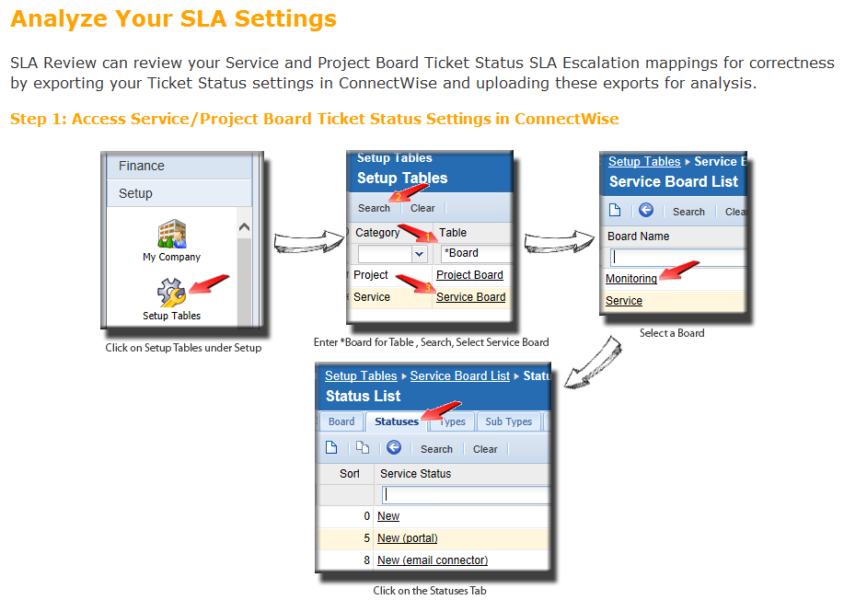
SLAReview.com

Slide 50
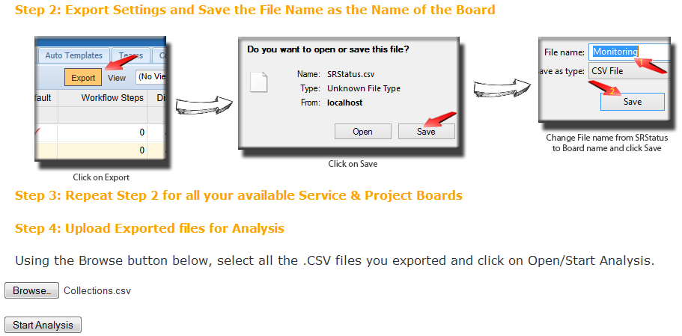
SLAReview.com

Slide 51
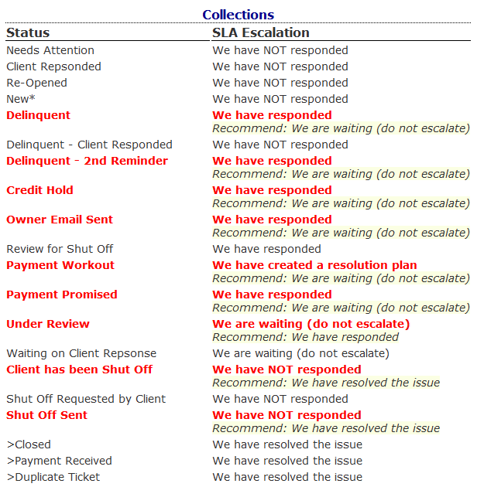

Slide 52
Goals
Prove your SLA KPIs can be as important as your P&L report
Prove that SLA Escalation to Ticket Status mapping is not up to interpretation or personal preference but is logic based
Prove that correcting your SLA Escalation to Ticket Status mapping will not break your Workflow or Reports
Ensure that when you return to your offices, you can and will actually apply what you have learned today

Slide 53
Conclusion
Q & A

